Slide 1
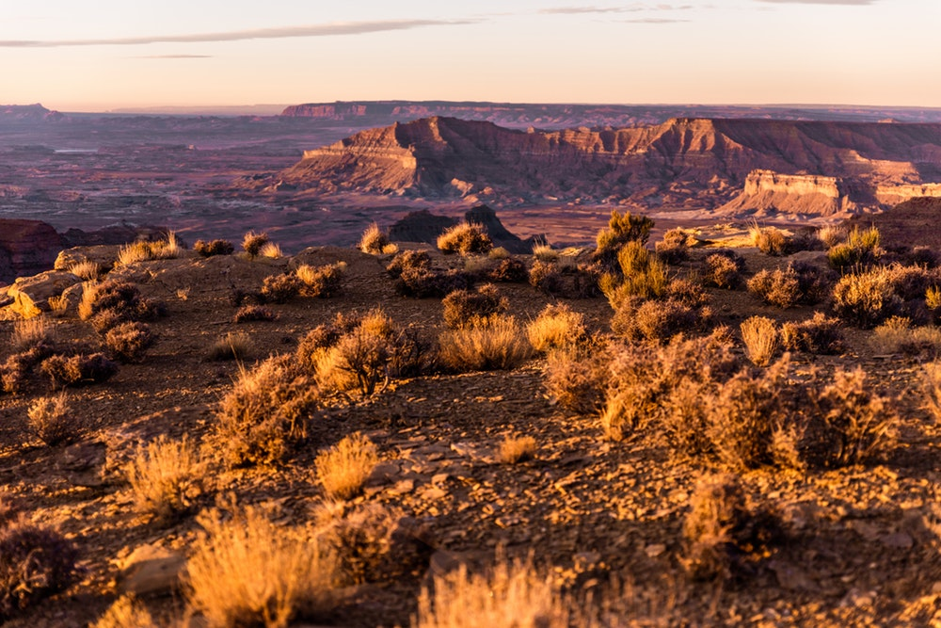
DESERT
ENVIRONMENTAL SCIENCE

Slide 2
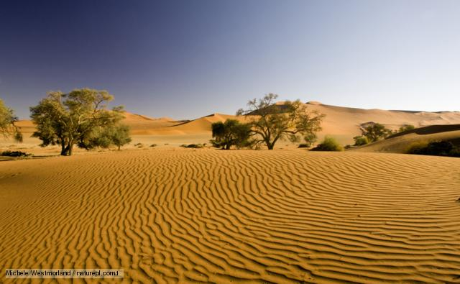

DESERT CHARACTERISTICS AND LOCATION
Deserts biomes are widespread and cover at least a third of the surface of the surface of the earth
Deserts occur a long distance away from the coasts. In these locations, moisture coming from oceans and seas does not reach the land
Deserts are divided into four categories hence there are numerous of them in many areas across the world
The subtropical Sahara in Africa is the larges hot desert biome. However, the overall largest desert is the Antarctica- a polar desert
Deserts receive little rainfall of about 50cms a year
Temperatures are extreme during the day and cold at night in deserts

Slide 3
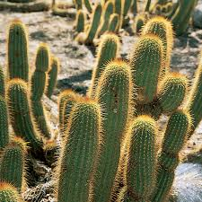
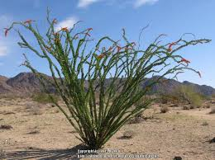
DESERT BIOME PLANTS
The cacti, small shrubs, succulents and grass are the most common plants in the desert. However, other plants such as Mugma tree, Desert Ironwood, Ocotillo, Brittle Bush just but a few thrive in desert conditions
To help them thrive in such difficult climatic conditions, these plants have developed certain unique adaptations
The most common are storage of water in stems and leaves, coverings of wax on eaves, shedding leaves, aimed at minimizing the loss of water.
Some have also developed long tap roots to help them reach the water table
The cactus has managed to survive these conditions for many years because it has shallow roots hence being able to soak up little rain and moisture available before evaporation

Slide 4

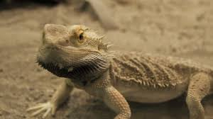
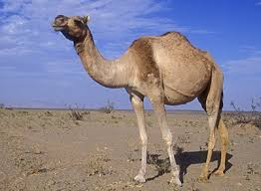
DESERT BIOME ANIMALS
In spite deserts experiencing harsh climatic conditions, many animals thrive here
Such animals have unique adaptations to help them remain cool and use less water
A camel, for example, can survive for many days without the availability of food and water due to the stored fat in its hump. A camel also has thick fur and underwool to help them survive harsh winter conditions
Foxes also survive here because of their burrowing and nocturnal living adaptations. The burrowing lifestyle ensures they avoid the high heat conditions during the day
Animals here have adaptations such as panting which helps them minimize heat, seasonal migration, and stretched periods of dormancy.
The other common animals in the desert include Coyotes, Thorny Devil, Desert Tortoise, Bobcats just but a few

Slide 5
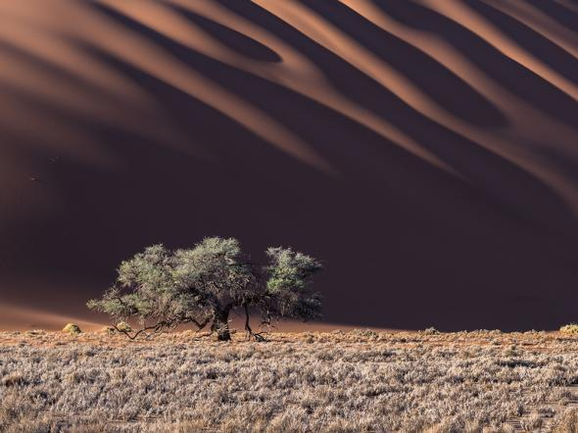
DESERT BIOME THREATS
Global warming is increasing drought incidences, which contributes to the drying of water holes. High temperatures may lead to high numbers of wildfires that alter the landscapes of deserts through the elimination of slow-growing trees and replacing them with fast-growing grasses
Irrigation which is utilized in agriculture can lead to high levels of salt in the soil and hence cannot support plants.
Grazing animals also is threat to many desert plants and animals. This act deprives these plants and animals food and also leads to desertification
In addition, potassium cyanide mainly used in mining gold can may be poisonous to wildlife
When used carelessly, off-road vehicles can be hazardous to desert habitats.

Slide 6
SOLUTIONS TO DESERT THREATS
One way to ensure these threats do not exist is to use water resources efficiently. Using of the water resources efficiently and better control of salinization can help improve the conditions of arid lands
Engineering new methods of crop rotation can help protect the arid soils and the bushes
Planting plants with nitrogen fixing ability can paly a fundamental role in restoring the soil fertility
People can also dig artificial grooves on the surface to help in retaining water from the rain

Slide 7
BIBLIOGRAPHY
Grady, C. (2017). The desert biome.
Nabhan, G. P., & Holdsworth, A. R. (1999). State of the desert biome: uniqueness, biodiversity, threats and the adequacy of protection in the Sonoran bioregion. Arizona-Sonoran Desert Museum.
Wallace, A., Romney, E. M., & Hunter, R. B. (1980). The challenge of a desert: revegetation of disturbed desert lands. Great Basin Naturalist Memoirs, 216-225.
https://www.nationalgeographic.com/environment/habitats/desert-threats/

